Slide 1
Low Power Scheduling For High Level Synthesis
Hardware Software Co-Design

Slide 2
Motivation
Key drivers of digital chip design: area, performance and power.
Increasing demand for personal computing devices.
Hence increasing demand for low-power.
Challenges in traditional approach design:
Time consuming
Unreliable.
Power issues must be addressed early in design cycle (system level) [1].

Slide 3
Motivation
Power consumption can be reduced by:
Reducing chip and package capacitance → Expensive.
Scaling the supply voltage → Need extra circuits.
Better design techniques → Cost-effective.
Power management strategies → significant power savings.
Solution: Integrate power scheduler in High Level Synthesis (HLS) [1].

Slide 4
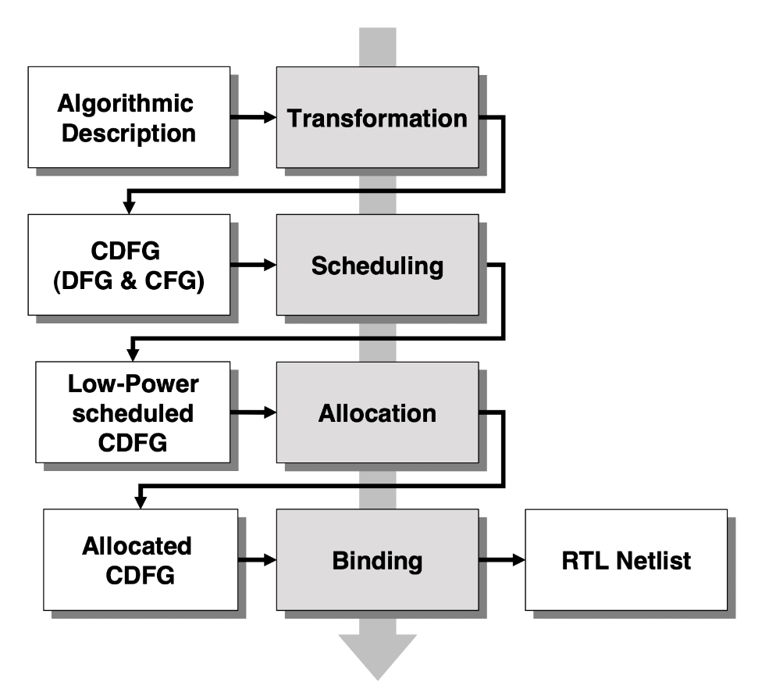
Background
High Level Synthesis: Translation function from behavioural to structural description [3].
Required behaviour -> Structure that implements the behaviour.
HLS consists of three phases [1]:
Scheduling: which clock cycle?
Allocation: how many resources?
Binding: which operation to which resource?
Fig. 1: HLS Design Flow [1]

Slide 5
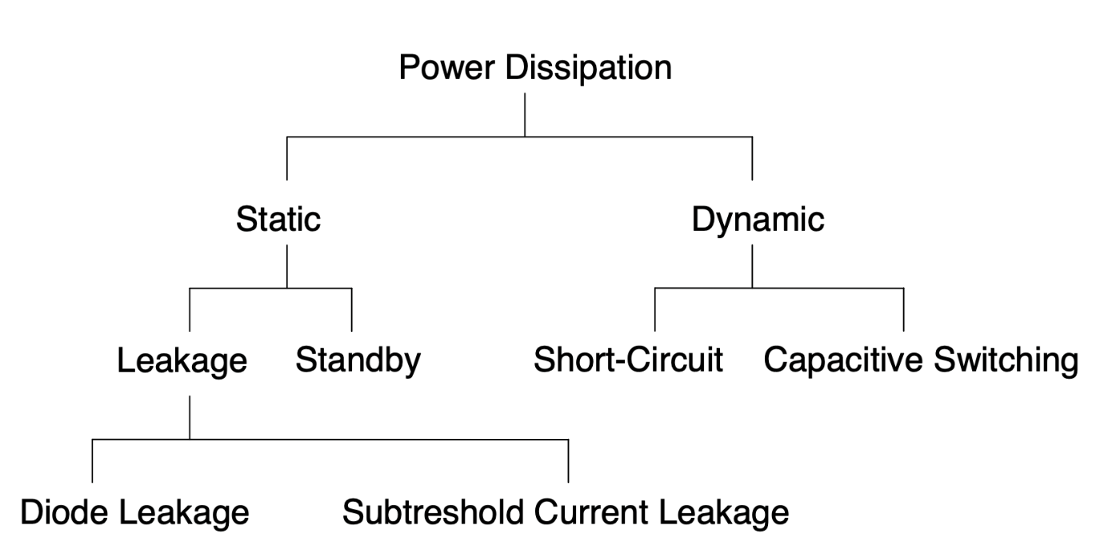
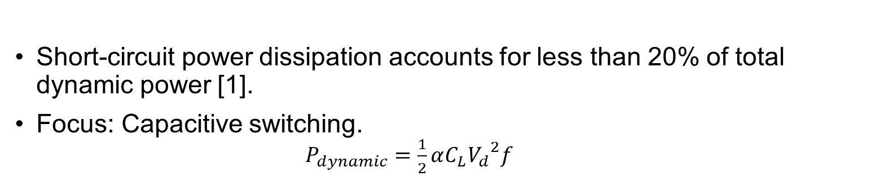
Background
Fig. 2: Sources of power dissipation
Short-circuit power dissipation accounts for less than 20% of total dynamic power [1].
Focus: Capacitive switching.
$P_{dynamic}=\frac{1}{2}αC_{L}{V_{d}}^{2}f$

Slide 6
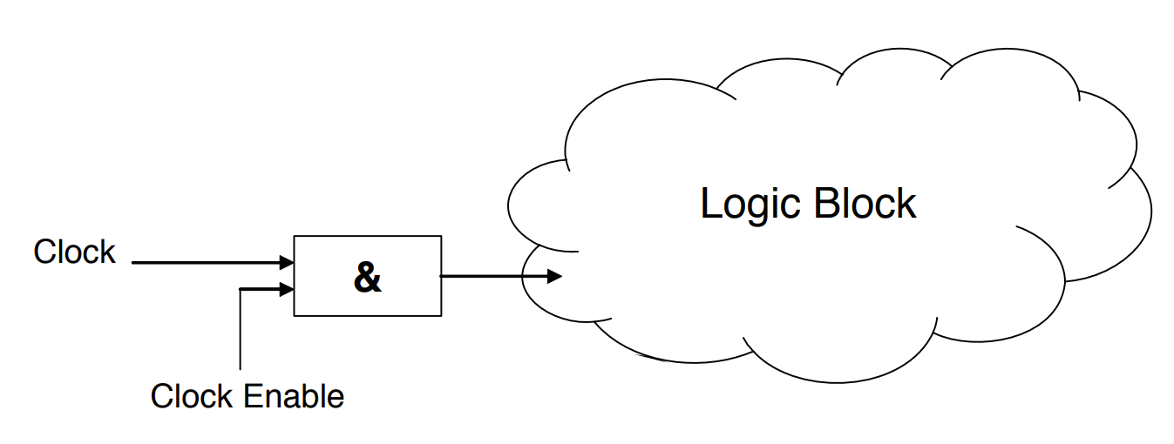
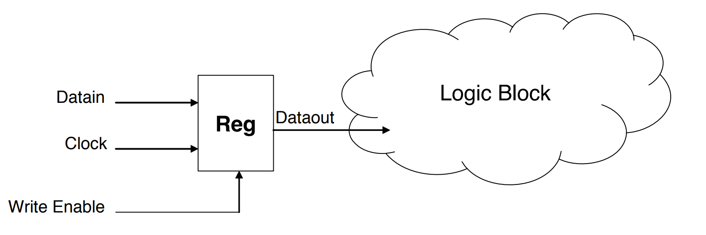
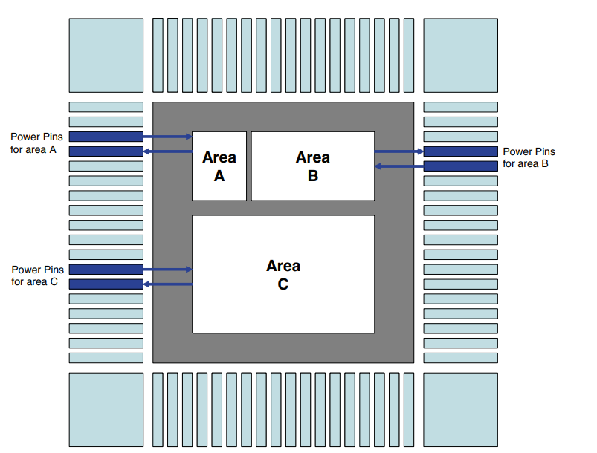
Background
Power Reduction Methods
Fig. 3: Gate clock [1]
Fig. 4: Guarded evaluation [1]
Fig. 5: Power down [1]

Slide 7
Strategy
Goal 1: Dedicated turn-on and turn-off mechanisms.
Goal 2: Minimizing control components for those mechanisms.
Technique: Clock gating, power down or write enables for guard.
Exploitation of idleness of device.
Integration of low power method in scheduling process.

Slide 8
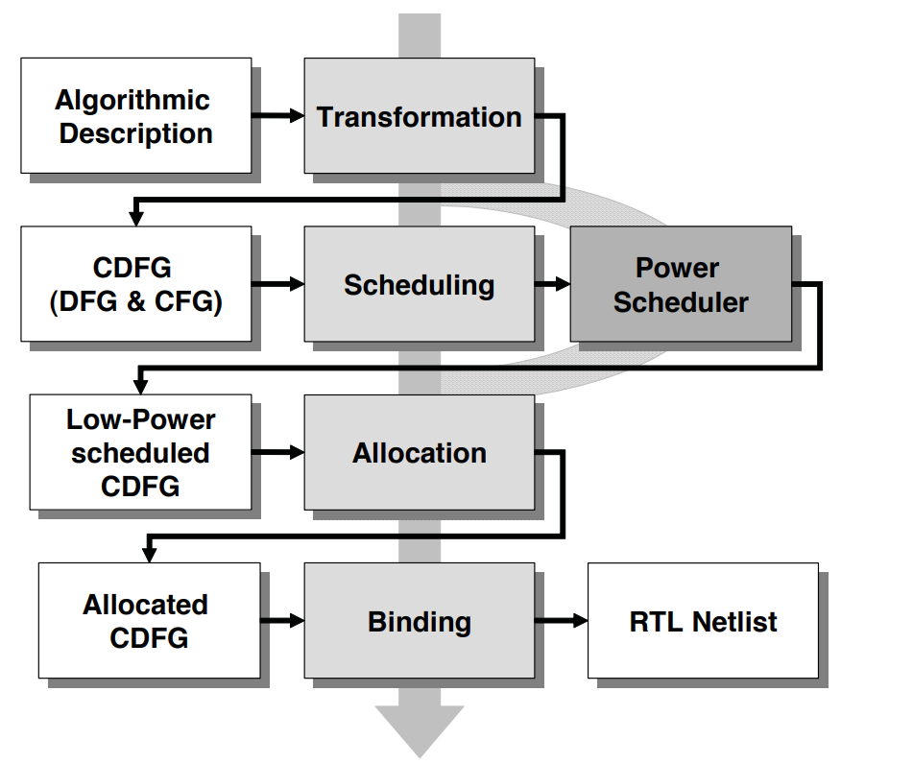
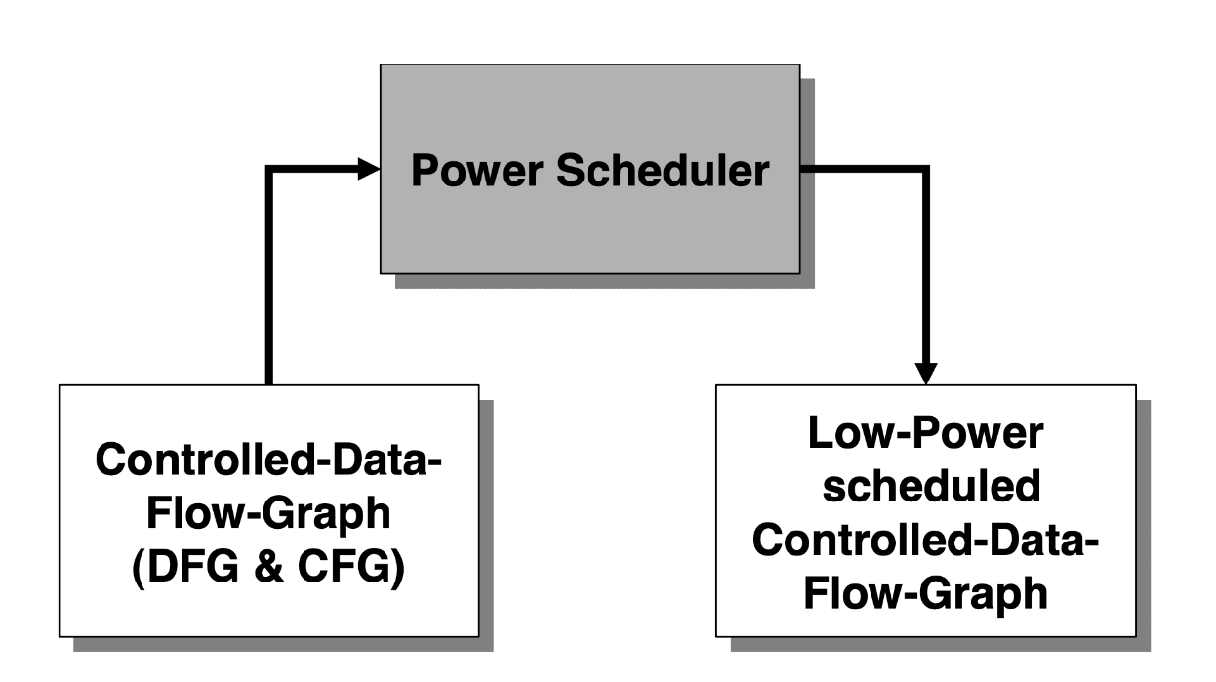
Background
Power Scheduler: alternative scheduling technique for power reduction.
Path-based scheduling technique.
Fig. 6: Integration of Power scheduler in HLS design flow. [1]
Fig. 7: Input and output of Power Scheduler [1].

Slide 9
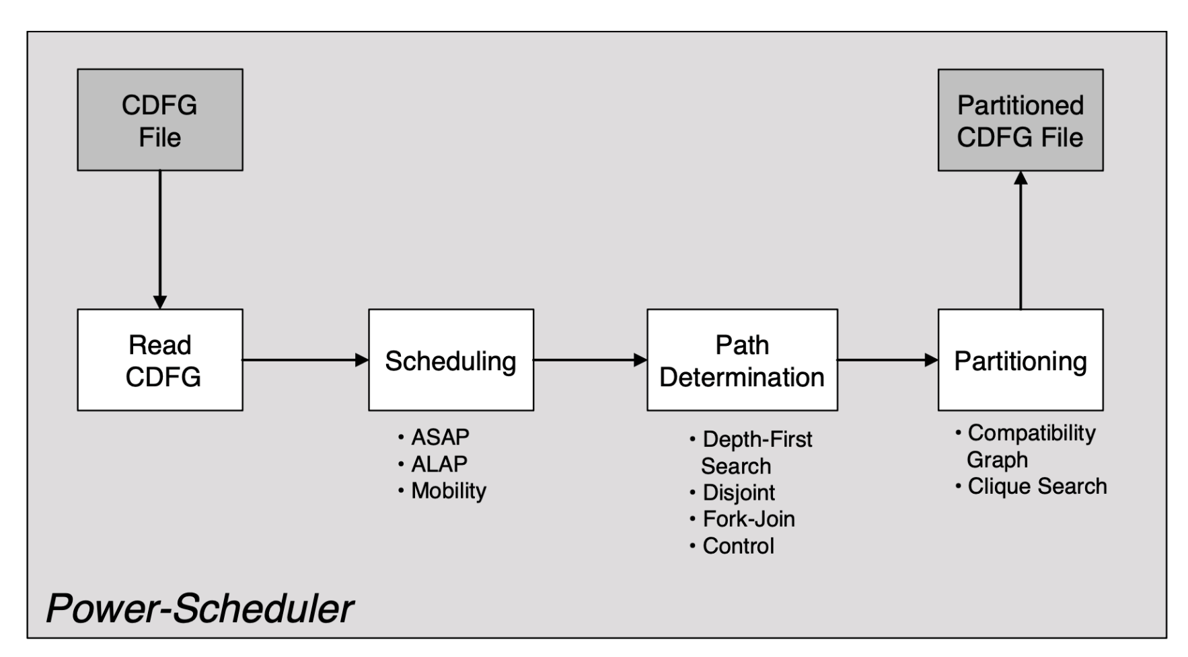
Background
Fig. 8: Steps of Power Scheduler [1].

Slide 10
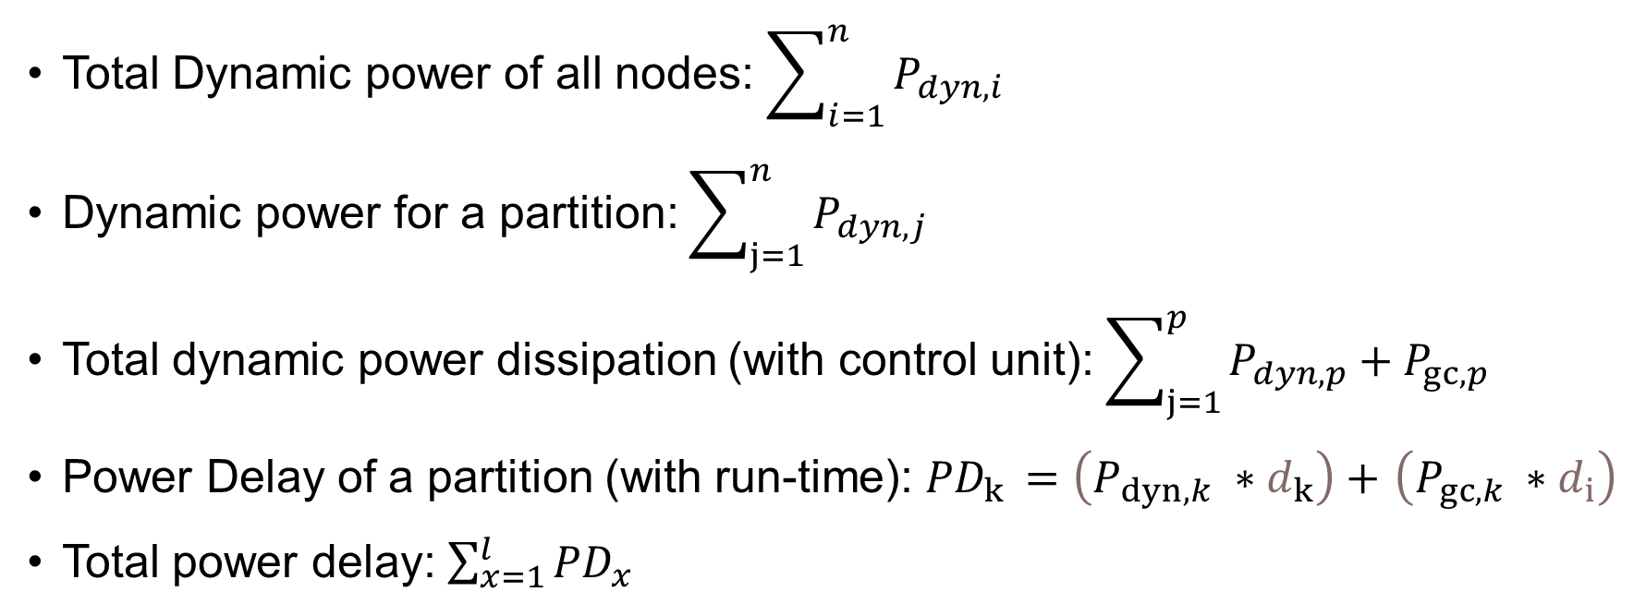
Mathematical Implementation
Total Dynamic power of all nodes: $\sum_{i=1}^{n}{P_{dyn,i}}$
Dynamic power for a partition: $\sum_{j=1}^{n}{P_{dyn,j}}$
Total dynamic power dissipation (with control unit): $\sum_{j=1}^{p}{P_{dyn,p}}+P_{gc,p}$
Power Delay of a partition (with run-time): ${PD}_{k }=\left(P_{dyn,k} ∗d_{k}\right)+$ $\left(P_{gc,k} ∗d_{i}\right)$
Total power delay: $\sum_{x=1}^{l}{{PD}_{x}}$

Slide 11
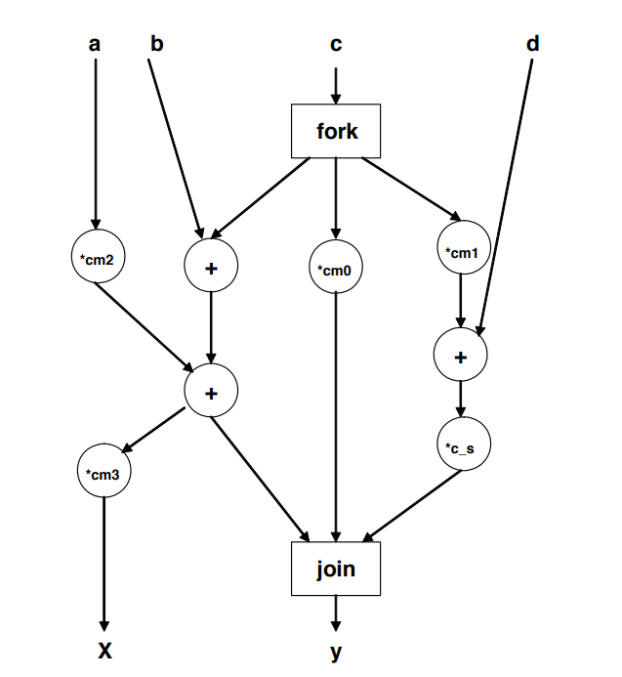
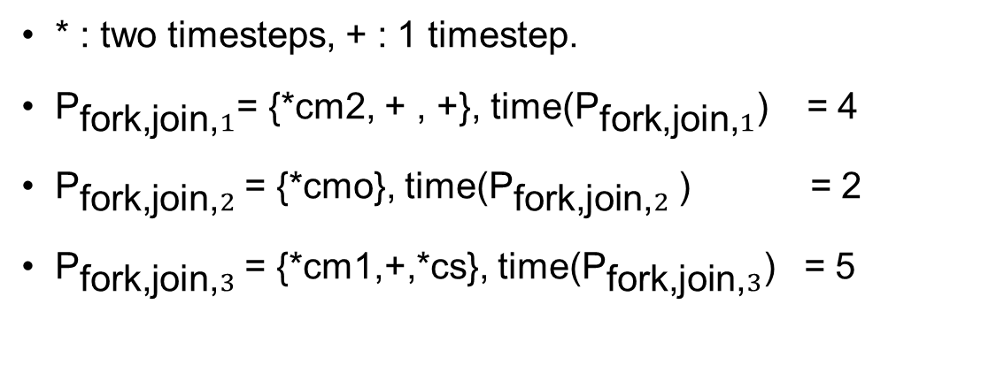
Fork-Join path calculation
* : two timesteps, + : 1 timestep.
${\text{P}}_{\text{fork}\text{,}\text{join}\text{,}1}$= {*cm2, + , +}, time(${\text{P}}_{\text{fork}\text{,}\text{join}\text{,}1}$) = 4
${\text{P}}_{\text{fork}\text{,}\text{join}\text{,}2}$= {*cmo}, time(${\text{P}}_{\text{fork}\text{,}\text{join}\text{,}2}$) = 2
${\text{P}}_{\text{fork}\text{,}\text{join}\text{,}3}$= {*cm1,+,*cs}, time(${\text{P}}_{\text{fork}\text{,}\text{join}\text{,}3}$) = 5
Fig. 9: Fork-join path analysis [2].

Slide 12
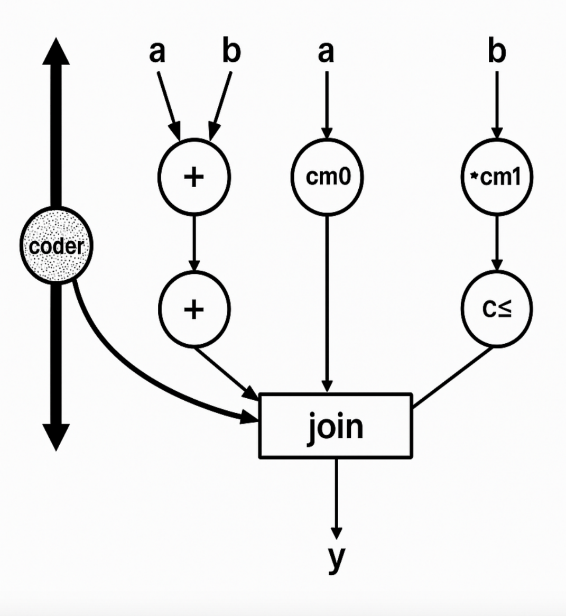
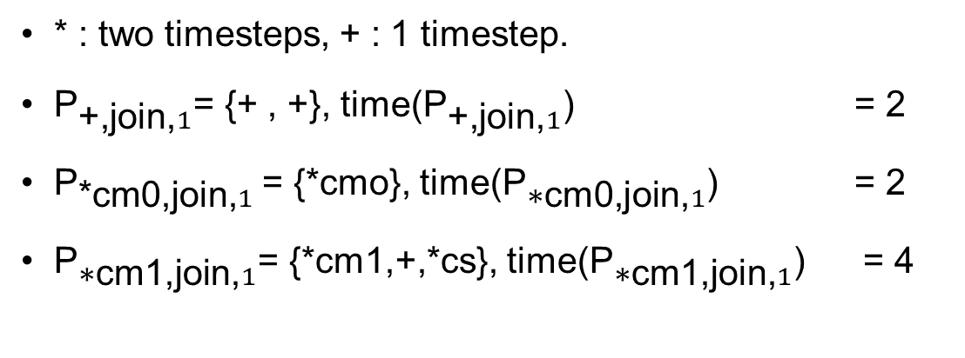
Control path calculation
* : two timesteps, + : 1 timestep.
${\text{P}}_{\text{+}\text{,}\text{join}\text{,}1}$= {+ , +}, time(${\text{P}}_{\text{+}\text{,}\text{join}\text{,}1}$) = 2
${\text{P}}_{\text{*}\text{cm}\text{0,}\text{join}\text{,}1}$= {*cmo}, time(${\text{P}}_{\text{∗}\text{cm}\text{0,}\text{join}\text{,}1}$) = 2
${\text{P}}_{\text{∗}\text{cm}\text{1}\text{,}\text{join}\text{,}1}$= {*cm1,+,*cs}, time(${\text{P}}_{\text{∗}\text{cm}\text{1}\text{,}\text{join}\text{,}1}$) = 4
Fig. 10: Control path analysis [2].

Slide 13
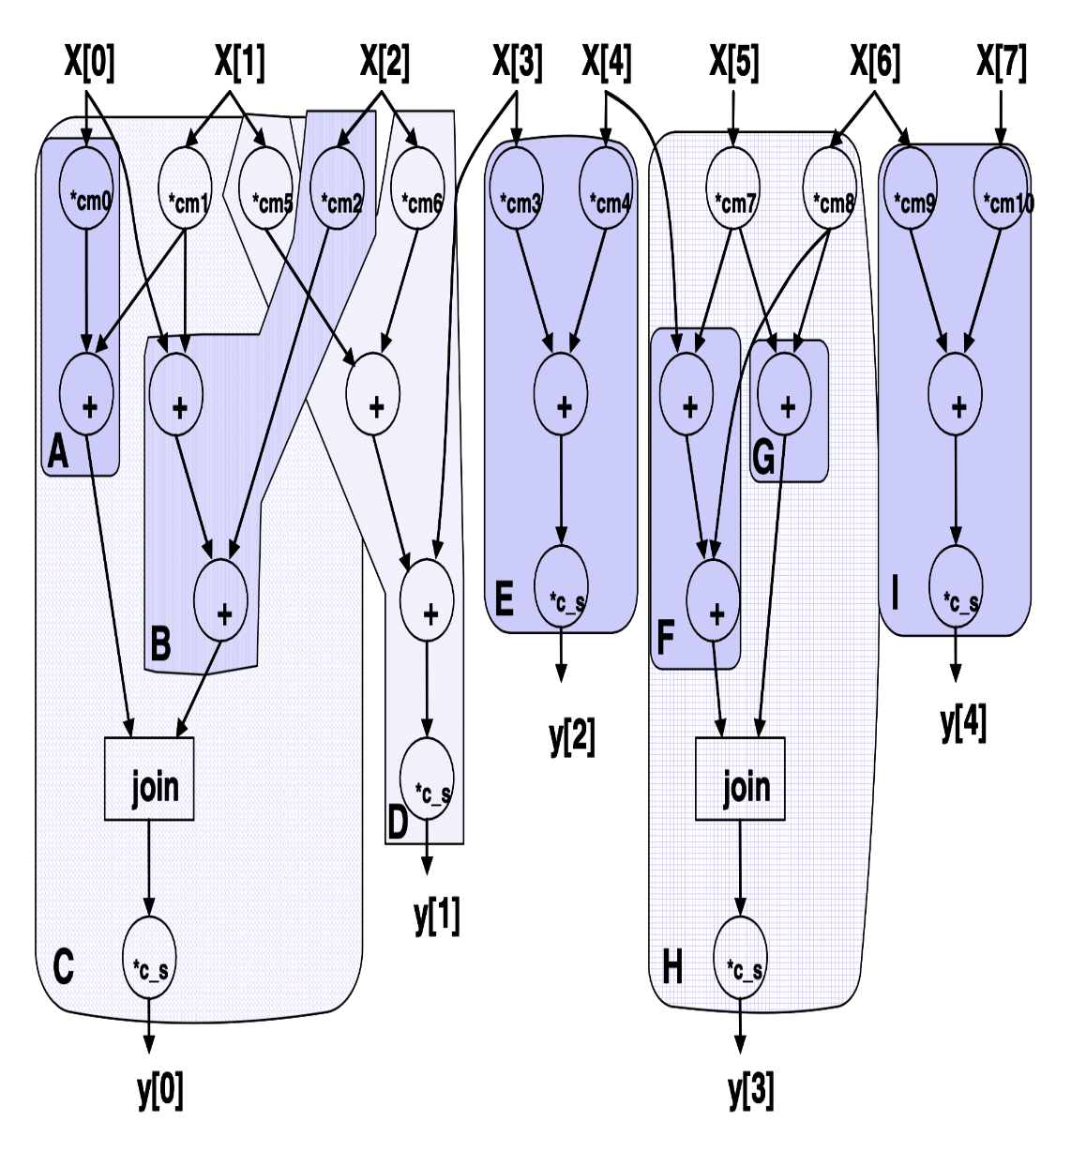
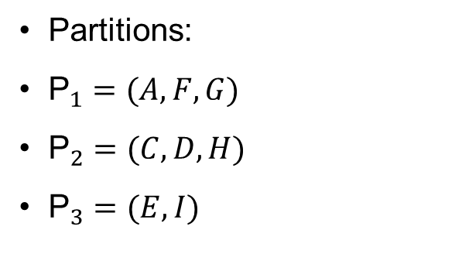
Implementation
Partitions:
${\text{P}}_{1}=(A, F, G)$
${\text{P}}_{2}=(C, D, H)$
${\text{P}}_{3}=(E, I)$
Fig. 11: Mpeg-2 algorithm example to determine partitions [1].

Slide 14
Overview and Conclusion
Low power driven synthesis is discussed.
A developed power scheduler is the focus.
Scheduler produces partitioned CDFG.
Partition allows for dedicated turn-on and turn-off mechanism.
Part of MPEG-2 algorithm is used as an example.
Energy saving of 15% achieved [4].

Slide 15
References
[1] Achim Rettberg, Bernd Kleinjohann, and Franz Rammig. “Low Power Driven High-Level Synthesis for Dedicated Architectures”. In: (Jan. 2006).
[2] Achim Rettberg and Franz Rammig. “Integration of Energy Reduction into High-Level Synthesis by Parti- tioning”. In: From Model-Driven Design to Resource Management for Distributed Embedded Systems. Ed. by Bernd Kleinjohann et al. Boston, MA: Springer US, 2006, pp. 225–234. ISBN: 978-0-387-39362-9.
[3] M.C. McFarland, A.C. Parker, and R. Camposano. “The high-level synthesis of digital systems”. In: Proceedings of the IEEE 78.2 (1990), pp. 301–318. DOI: 10.1109/5. 52214.
[4] A. Rettberg and F.J. Rammig. “A new design partitioning approach for low power high-level synthesis”. In: Third IEEE International Workshop on Electronic Design, Test and Applications (DELTA’06). 2006, 6 pp.–148. DOI: 10. 1109/DELTA.2006.8.

